Slide 1
Analyzing the Impact of Car Features on Price and Proﬁtability
Data set with all task solution:https://docs.google.com/spreadsheets/d/1e1UFcypusKFJFGdivsfIoZr1gXayamQT/edit?usp=sharing&ouid=113704175419499417107&rtpof=true&sd=true

Slide 2
Project Description:
Overview:
This project aims to study how different features of cars affect their prices and proﬁtability in the automotive industry. By analyzing a dataset containing information about car models, their speciﬁcations, and market data, the goal is to offer insights that can assist car manufacturers in making better pricing and product development decisions.
Business Problem:
In today's fast-changing automotive market, it's crucial for manufacturers to understand what drives consumer demand and how to set prices effectively to maximize proﬁts.
This project tackles the challenge of ﬁnding the balance between meeting consumer needs, incorporating desirable features, and setting proﬁtable prices.

Slide 3
Project Description:
Data Sources:
The main source of data for this project is a dataset called "Car Features and MSRP," which was obtained from Kaggle. This dataset includes details about over 11,000 car models, such as their make, model, year, engine speciﬁcations, transmission type, market category, fuel eﬃciency, popularity, and manufacturer's suggested retail price (MSRP).
Data Cleaning and Preprocessing:
Before starting the analysis, we cleaned and processed the data to ensure its accuracy and reliability. This involved tasks like handling missing values, removing duplicates, standardizing data formats, and addressing any inconsistencies or errors in the dataset.

Slide 4
Approach:
Analytical Methods:
We used various analytical methods, including descriptive statistics, data visualization, regression analysis, and correlation analysis. These methods helped us uncover patterns, relationships, and insights within the dataset.
Modelling Techniques:
Regression analysis was utilized to identify the key factors inﬂuencing car prices. This technique helps quantify the relationship between independent variables (car features) and the dependent variable (car price). By examining coeﬃcient values, we assessed the relative importance of different features.

Slide 5
Tech-Stack Used:
Tools:
Our primary tool for analysis was Microsoft Excel because of its versatility in handling data manipulation, analysis, and visualization tasks. Excel's built-in functions, pivot
tables, and charting capabilities facilitated the exploration and interpretation of the dataset.

Slide 6
Insight:
UNDERSTANDING THE DATA AND DATA CLEANING - Read and understand the data then check for null & missing values to clean the data before analysis. And found that there are some columns have blank cell and column named MODEL has irrelevant data such as dates.
So first I treated this column and replace all dated values with N/A. because every car have some unique feature that lead to different models name so it can’t be deleted.
Used =COUNTBLANK function to find missing values and I found that there are some columns such as Engine HP, Engine fuel type, Engine cylinder and No. of doors have some missing values.
To treat the missing values I’ve imputed these values with =MEDIAN function in order to get appropriate values to fill the blank cell.
Thereafter I’ve treated column engine fuel type which contain categorical values so I replaced the blank cell with N/A values so that they are not included in the analysis or cause error result.

Slide 7
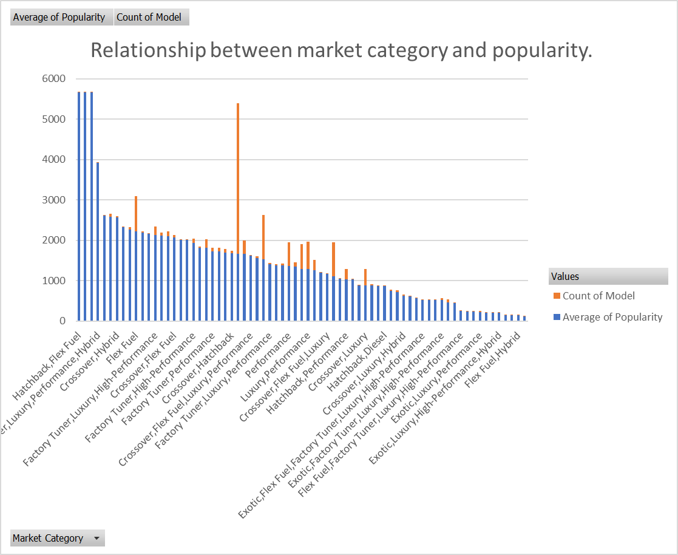
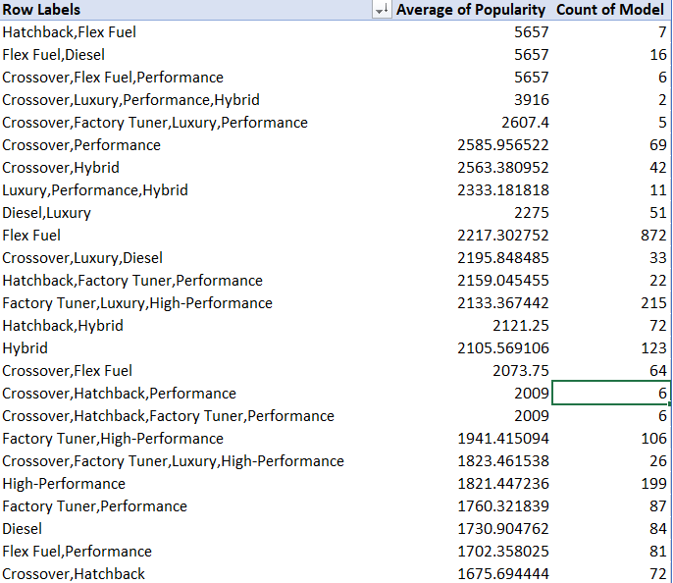
Task 1
How does the popularity of a car model vary across different market categories?

Slide 8
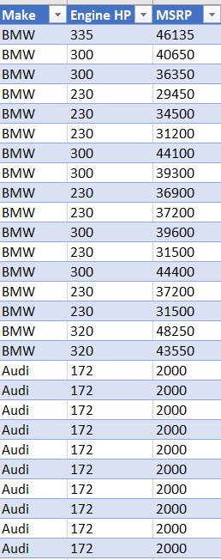
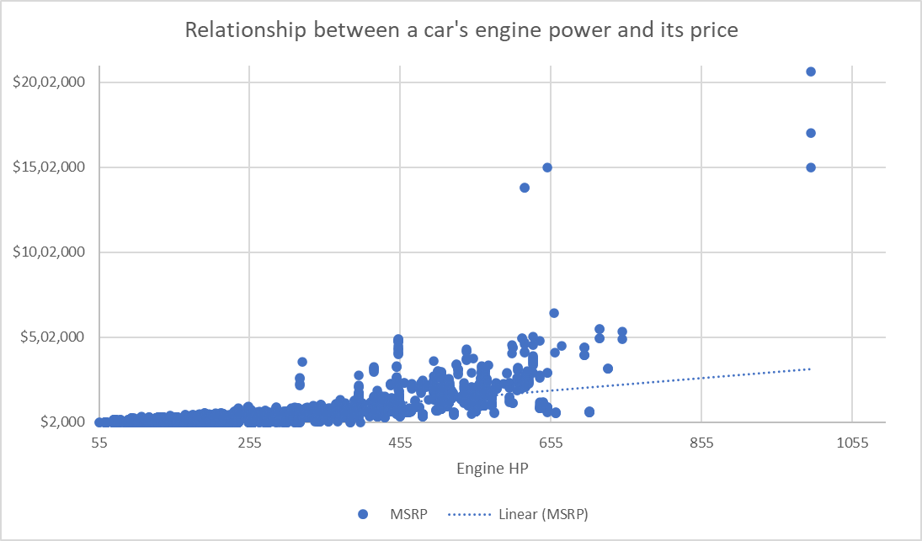
Task 2
What is the relationship between a car's engine power and its price?

Slide 9
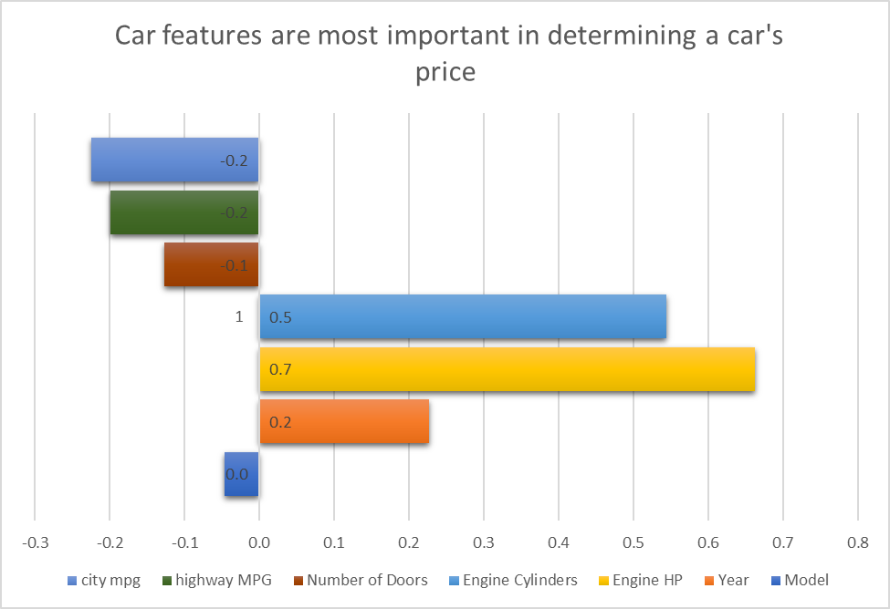
Task 3
Which car features are most important in determining a car's price?

Slide 10
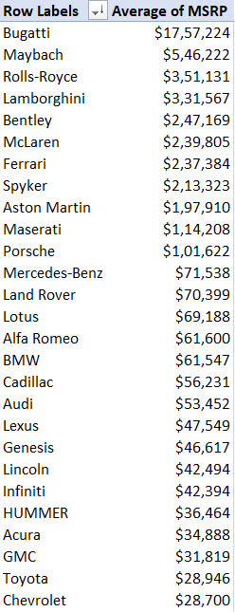
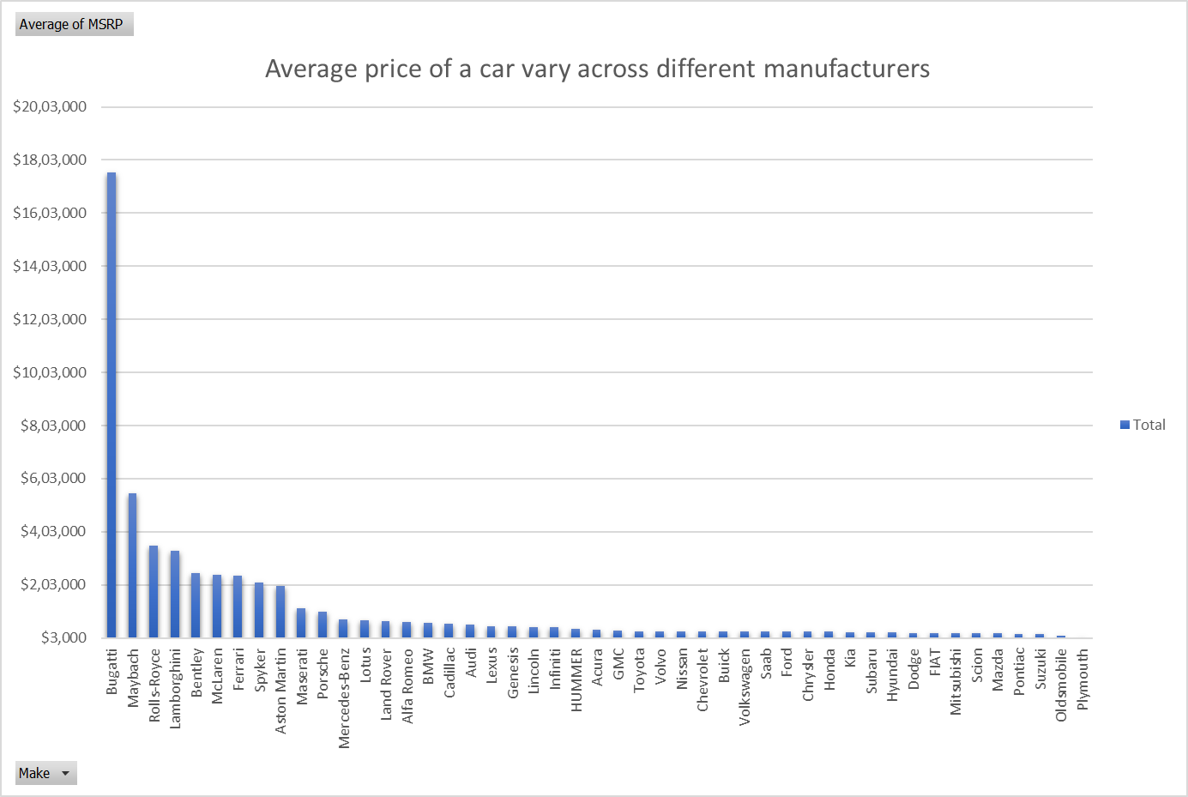
Task 4
How does the average price of a car vary across different manufacturers?

Slide 11
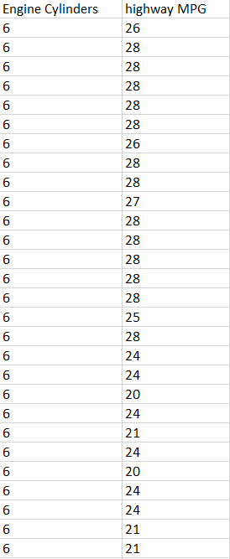
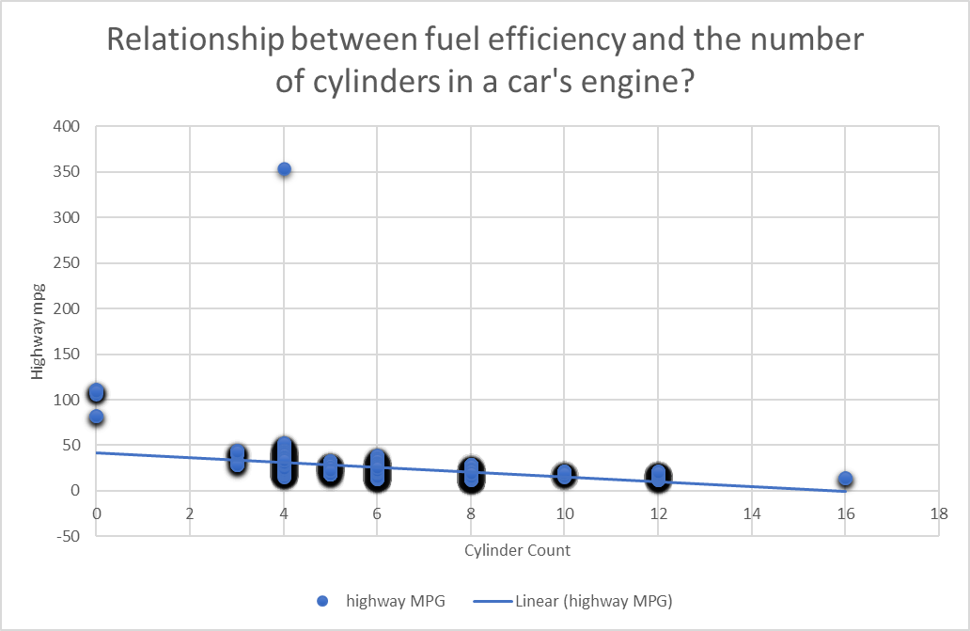
Task 5
What is the relationship between fuel efficiency and the number of cylinders in a car's engine?

Slide 12
DASHBOARD TASKS

Slide 13
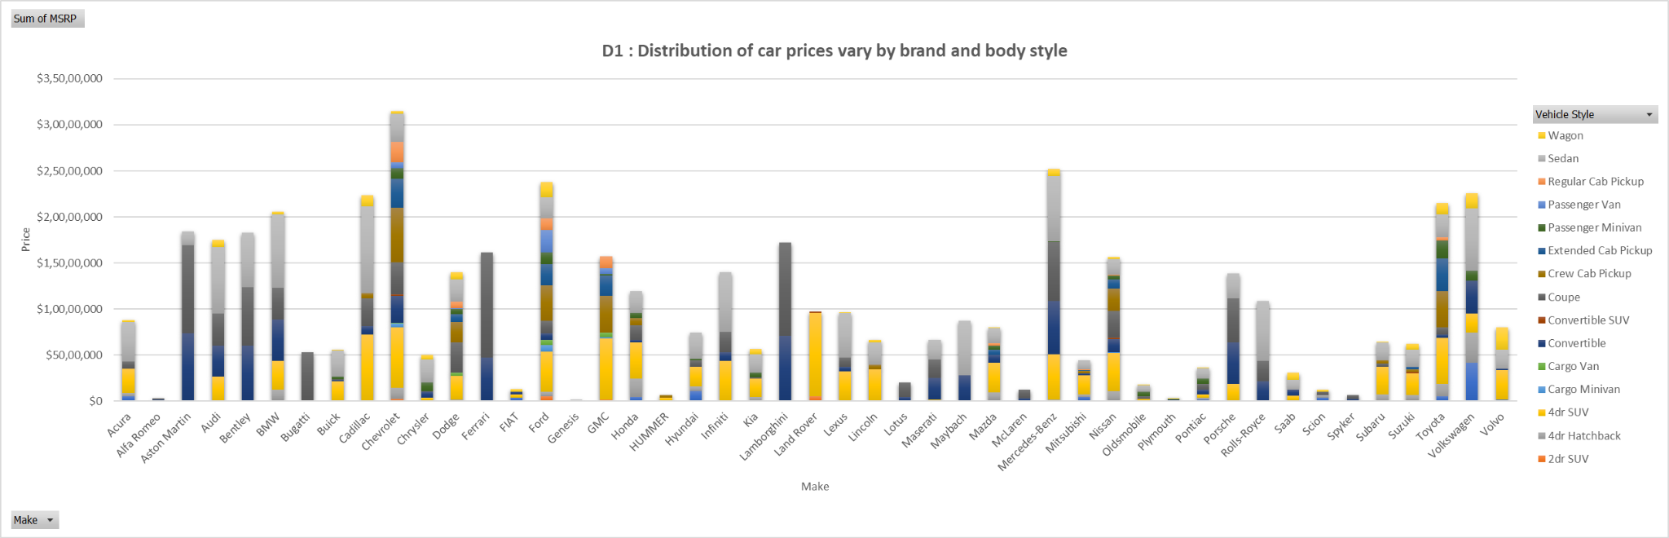
TASK 1
How does the distribution of car prices vary by brand and body style?

Slide 14
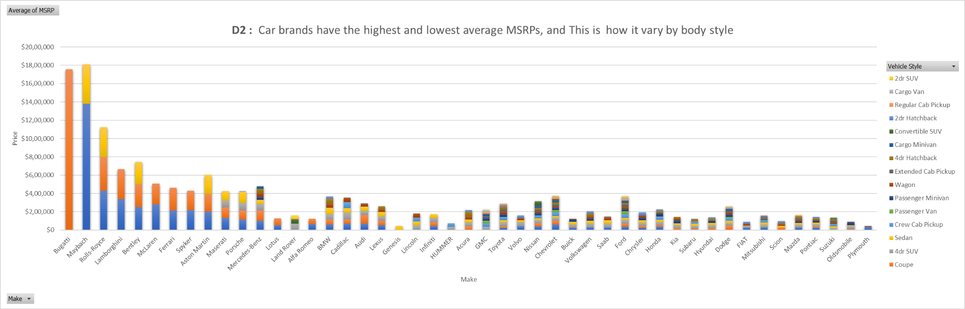
TASK 2
Which car brands have the highest and lowest average MSRPs, and how does this vary by body style?

Slide 15
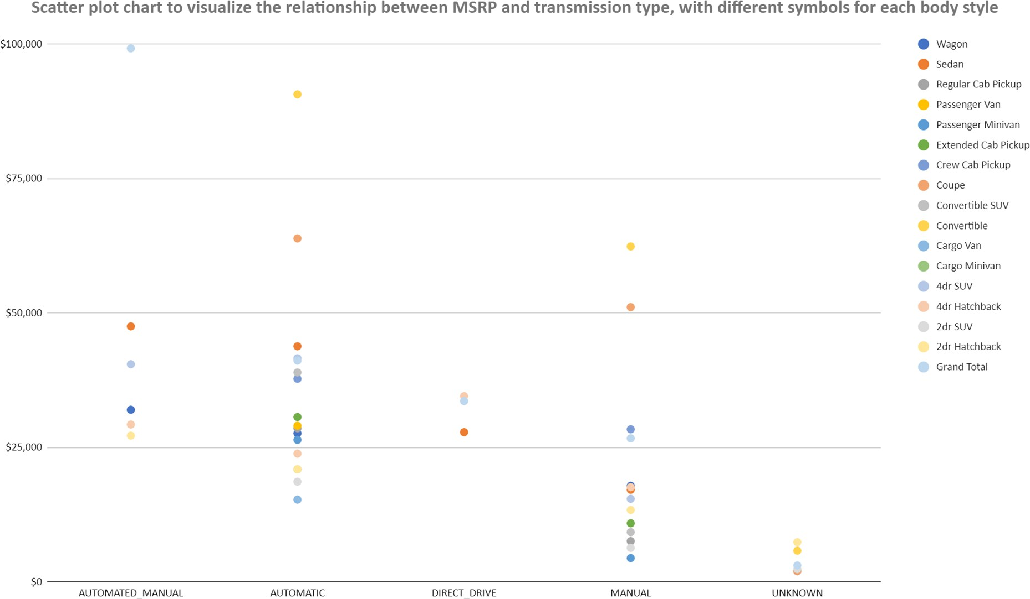
TASK 3
How do the different feature such as transmission type affect the MSRP, and how does this vary by body style?

Slide 16
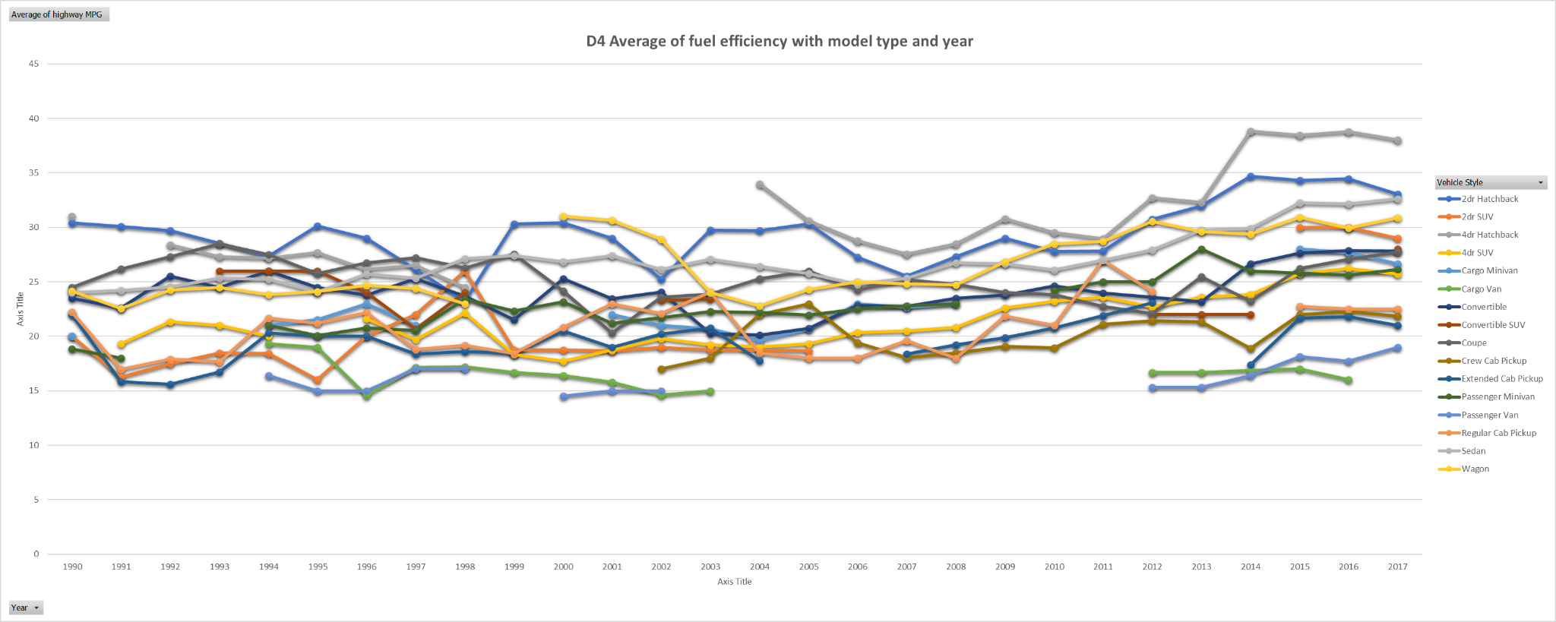
TASK 4
How does the fuel efficiency of cars vary across different body styles and model years?

Slide 17
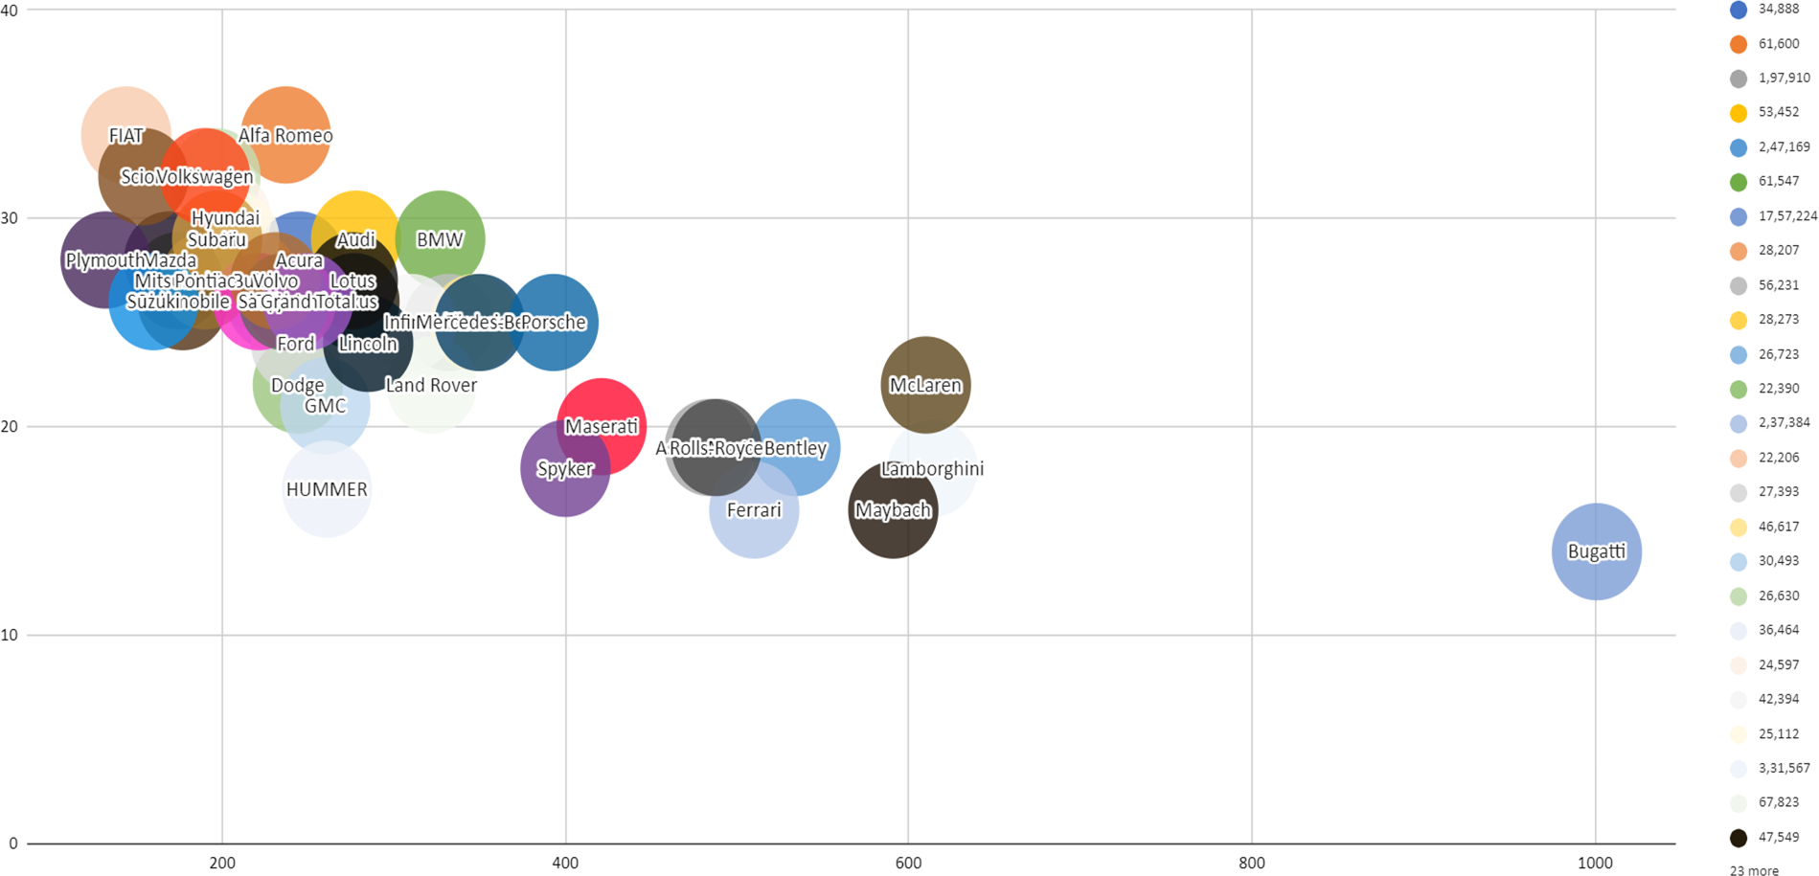
TASK 5
How does the car's horsepower, MPG, and price vary across different Brands?

Slide 18
Key Insights:
We found several key insights, such as the signiﬁcant impact of engine power on car prices, the varying popularity of car models across market categories, and the relationship between fuel eﬃciency and engine speciﬁcations.
Relevance to Business Problem:
These insights directly address the business problem by providing actionable information for car manufacturers to optimize pricing strategies, identify proﬁtable market segments, and prioritize product development efforts.
Recommendations:
Based on the insights gained, we recommend that car manufacturers focus on developing fuel-eﬃcient models, strategically price cars based on feature importance, and tailor marketing strategies to target popular market categories.

Slide 19
Results:
Visualization:
We used visualizations such as pivot tables, scatter plots, and bar charts to present the results obtained from the analysis. These visualizations help stakeholders interpret the ﬁndings more effectively and facilitate decision-making.
Discussion:
The results obtained from the analysis have signiﬁcant implications for car manufacturers, providing valuable insights into consumer preferences, pricing dynamics, and market trends. These ﬁndings can guide strategic decisions aimed at enhancing proﬁtability and competitiveness.
Future Directions:
Moving forward, additional analysis could explore dynamic pricing strategies, incorporate real-time market data, and leverage advanced machine learning techniques for predictive modeling. Furthermore, ongoing monitoring of market trends and consumer preferences is essential for staying competitive in the automotive industry.

Slide 20
THANK YOU
AYUSH YADAV

